Slide 1
FY2021 Budget Primer
Agenda
Fast Facts and Budget Timeline
Organizational Factors Influencing Decisions:
Demographic and Economic Factors
Enrollment Factors
Funding Factors
Operating Factors
Budget Policy and Structure
Budget Process
Appendix
Engage. Inspire. Prepare.
January 28, 2020
Version 5.2

Slide 2
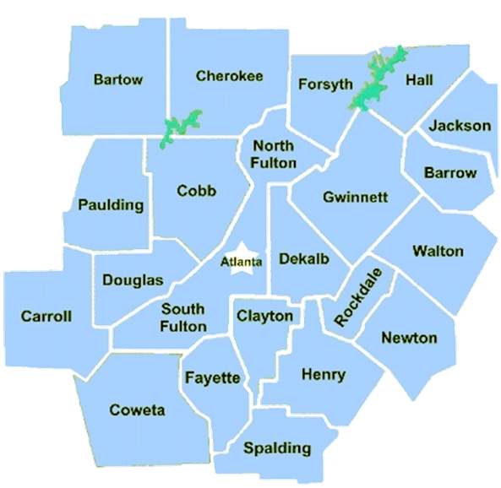
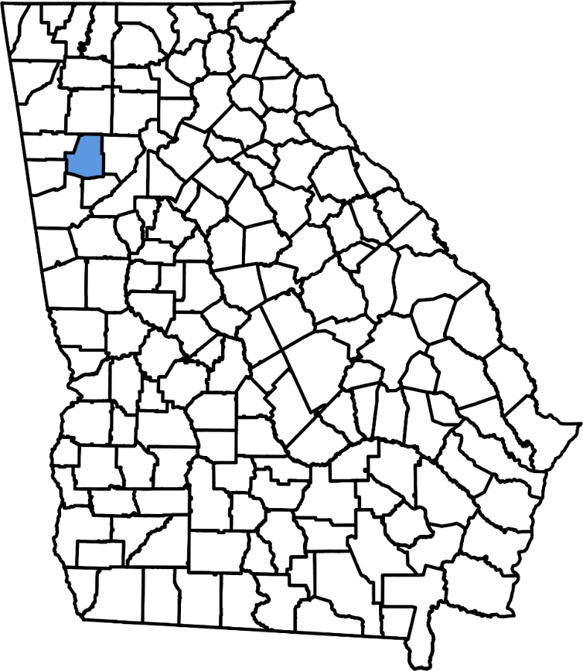
Fast Facts
1 | Fast Facts

Slide 3
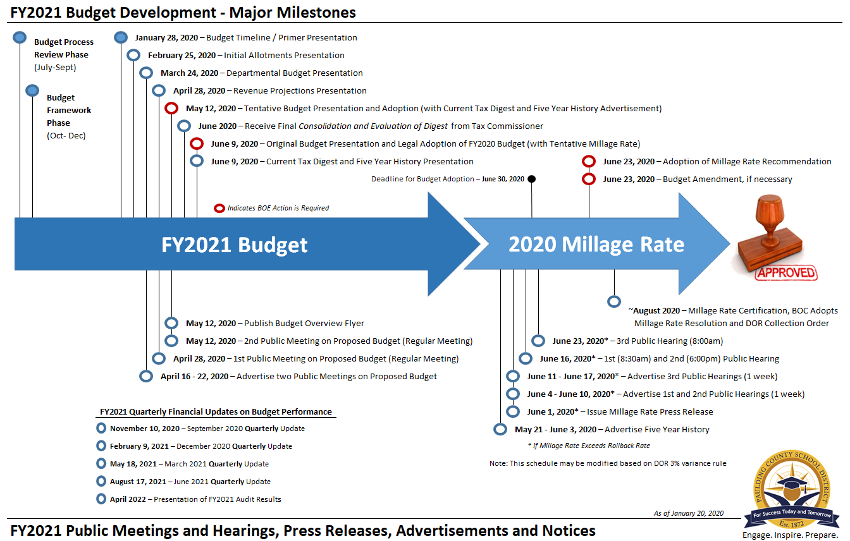
FY2021 Budget Approval Timeline
January 28, 2020
Budget Timeline and Primer Presentation
1 | Budget Timeline

Slide 4
Organizational Factors Influencing Decisions: Demographic and Economic Factors
Engage. Inspire. Prepare.

Slide 5
Tax Digest Overview
Tax Digest. The limited commercial and industrial tax base in Paulding County results in a lower net digest per student (NDPS), which reduces local funding. In FY2020, PCSD’s NDPS was approximately $148,000, which was $65,000 or 31% lower than the average large district in Georgia (enrollment >10,000).
NDPS Formula:
Property subject to a tax levy, after applicable exemptions (net digest) divided by the number of students
PCSD Example: $4.47 Billion
divided by 30,226 equals
$148k per Student
Source: GaDOR (Consolidated Tax Digest Summary), GaDOE Enrollment and Revenue/Expenditures Reports
2 | Budget Factors
Notes:
Students-per-household will impact this formula

Slide 6
Tax Digest: Net Digest per Student
Net Digest Allocation: Residential versus Non-Residential
What if Paulding County’s Digest was Similar to the Average Large District in Georgia?
Residential would need to increase 7% or $180 million
61% represents $126,300 Residential NDPS, compared to $121,200 in FY2020
Non-Residential would need to increase 207% or $2 billion
39% represents $81,800 Non-Residential NDPS, compared to $26,700 in FY2020 - an additional $55,100 per student
Source: Georgia Department of Revenue, Consolidated Tax Digest Summary - Large School Districts Average (enrollment >10,000)
2 | Budget Factors

Slide 7
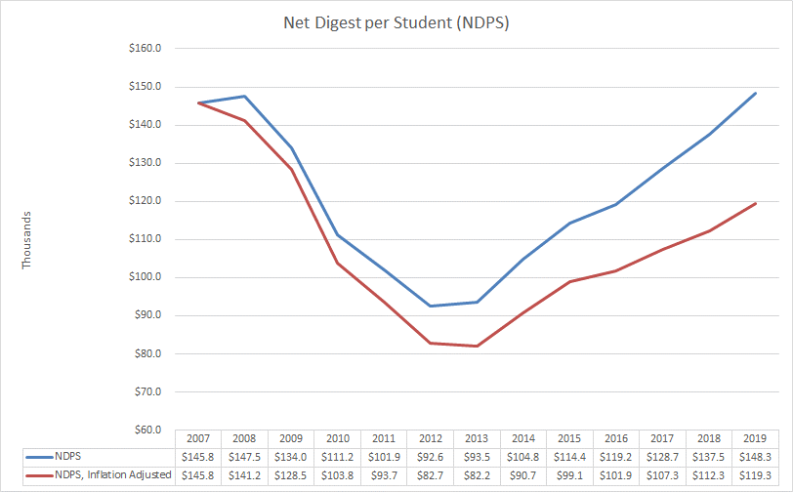
Tax Digest: Great Recession
Great Recession. While Paulding County’s housing-centric economy is recovering from the recession, the residual inflation-adjusted effect on the tax digest remains material. This is significant to note because approximately one-third of the District’s revenues comes from local sources.
Between fiscal years 2009 and 2014, the net digest decreased by 36% or $1.5 billion
FY2020 net digest per student (NDPS) remains 18% lower than FY2009, inflation adjusted
Source: Bureau of Labor Statistics, CPI Calculator (measured in January, annually) and Georgia Department of Revenue, Consolidated Tax Digest Summary
2 | Budget Factors

Slide 8
Tax Digest: Top 10
2 | Budget Factors

Slide 9
School-Age Children per Household
Large number of school-age children per household. Tax digest issues are exacerbated by the high number of school-age children per household in Paulding County, as there is not a correlating increase in funding because local funding is based on property tax values not the number of school-age children living in the home.
Source: http://www.census.gov/quickfacts on 1.13.20
* As of October 2018 Count
2 | Budget Factors

Slide 10
Organizational Factors Influencing Decisions: Enrollment Factors
Engage. Inspire. Prepare.

Slide 11
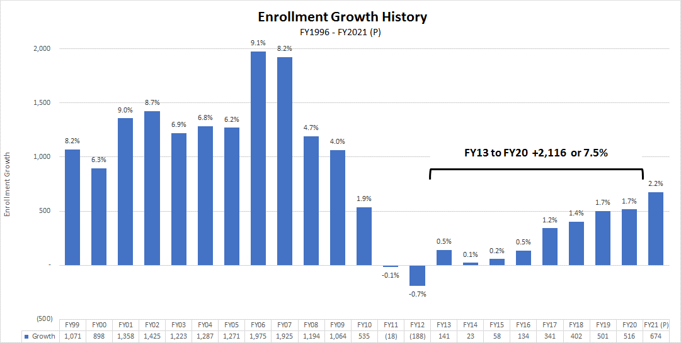
Enrollment Growth
Enrollment Growth. In the 8 years preceding the collapse of the housing market, the district experienced tremendous growth, increasing enrollment over 80% in fiscal years 2000 to 2007. Average enrollment growth declined in 2008 to 2011 by almost two-thirds. By 2012, enrollment was declining, compared to modest increases statewide. In 2013 to 2020 overall enrollment grew 2,116 or 7.5%. 2020 enrollment grew 1.7%, to 30,226.
Please Note: These are preliminary numbers and will be influenced by Kindergarten Registration, School Choice, Programs, etc.
2 | Budget Factors

Slide 12
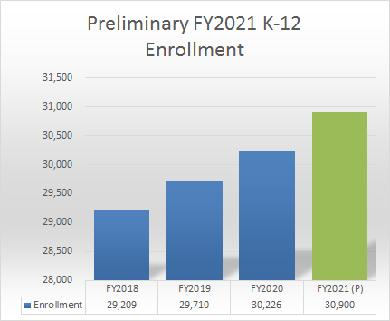
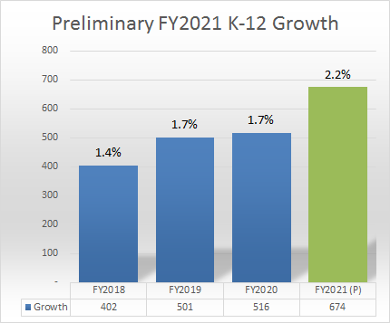
Preliminary Enrollment Growth
Please Note: These are preliminary numbers and will be influenced by Kindergarten Registration, School Choice, Programs, etc.
2 | Budget Factors
Notes:
Details are in the Appendix

Slide 13
Enrollment Metrics: Population & Birth Rate
Source: https://oasis.state.ga.us on 1.13.2020
2 | Budget Factors

Slide 14
Enrollment Metrics: Building Permits
Source: Paulding County Economic Development through October 2019 (annualized)
2 | Budget Factors

Slide 15
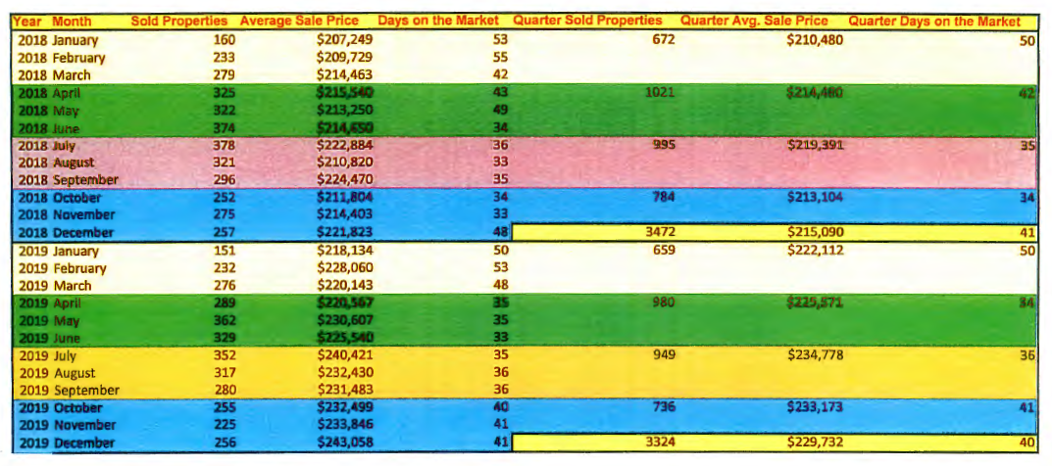
Enrollment Metrics: Home Sales
Change in 2019 (Calendar Year) Home Sales:
Properties Sold Decreased 148 or 4.3%
Days on the Market Decreased by 1 day or 2.4%
Average Sale Price Increased $14,642 or 6.8%
Source: Georgia FMLS Monthly Survey
2 | Budget Factors

Slide 16
ESEP Enrollment Growth
ESEP Enrollment Growth. Enrollment in Exceptional Students Educational Programs (ESEP) has increased dramatically over the past several years. In FY2019, the average additional cost per ESEP student was $1,802 or 23%, $7.8 million total.
40% Increase in ESEP since FY2014 (6 years)
Compared to 19% ESEP Statewide
Compared to 7% Overall Enrollment Growth
10% Greater Cost (local and state sources)
23% Greater Cost (local, state and federal sources)
Source: GaDOE Enrollment by Disability and Student Enrollment by Grade as of FY2020 (includes PK) and FY2019 Excess Cost Report
2 | Budget Factors
Notes:
11% increase over the past 2 years verses 2% in non-ESEP

Slide 17
Organizational Factors Influencing Decisions: Funding Factors
Engage. Inspire. Prepare.

Slide 18
Dependency on State Sources
Dependency on State Sources. With approximately 66% of revenue coming from state sources (compared to a statewide average of 52%) the District is highly susceptible to changes in state funding, including austerity reductions, Equalization Grant funding and changes in the Quality Basic Education (QBE) formula.
Source: GaDOE School System Revenue/Expenditures Report as of FY2019
2 | Budget Factors

Slide 19
School-Age Children per Household
State Budget Growth
2.3% Growth FY20 ($609m)
-.06 Growth FY20 Amd (-$159m)
2.1% Growth FY2021 ($566m)
2018: State Income Tax reduction of 0.25% (6.0% to 5.75%), with a provision to consider another 0.25% reduction in 2020
State Budget Highlights (Initial)
$144m Enrollment Growth ($32m Equalization)
$362m Salary Increase ($2,000 certified)
5% Increase in Transportation and “Others”
Bonds for COPS and Bonds for Buses
Monitoring Duel Enrollment Changes
TAVT Changes
Grant Changes
Source: Dr. Jeffery Dorfman, State Fiscal Economist – 1/21/20 Presentation to General Assembly
2 | Budget Factors

Slide 20
Low Wealth
Low Wealth. Despite economically favorable employment, income and free-and-reduced lunch statistics, PCSD is considered low wealth due to a limited commercial and industrial tax base and the large number of school-age children per household.
Revenue Rankings. FY2019 rankings against the 35 large school districts (enrollment >10,000) and all 180 districts in Georgia:
12th Largest District
31st in Local Revenue per Student (121 vs 180)
Average $1,331 less per Student
$40 million Total
8th in State Revenue per Student (92 vs 180)
Average $816 more per Student
$29 million Equalization Grant (3rd Largest)
24th in Total Revenue per Student (150 vs 180)
Average $698 or 7% less per Student
$21 million Total
Source: GaDOE School System Revenue/Expenditures Report as of FY2019
2 | Budget Factors

Slide 21
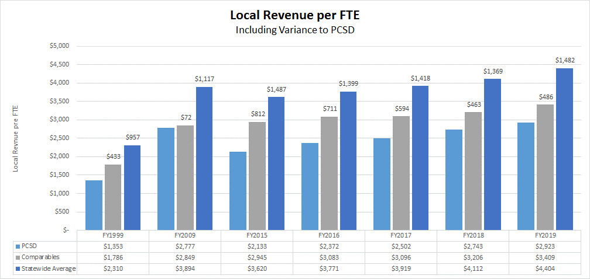
Low Wealth: Local per Pupil Funding
PCSD remains $486 lower in per-pupil local revenue than comparable districts or $1,482 lower than the statewide average.
Source: GaDOE School System Revenue/Expenditures Report as of FY2019
2 | Budget Factors

Slide 22
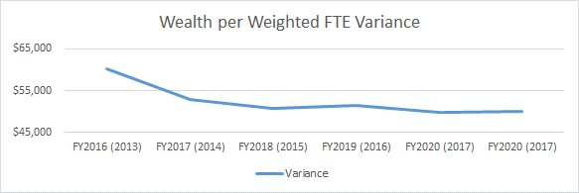
Equalization Grant
A stable variance between PCSD and Statewide Wealth-per-Weighted FTE could result in a minimal decline (assuming no changes in state funding)
2 | Budget Factors
Notes:
$394.9m total – since 2003
FY18 comes from EG for ALL Districts spreadsheet in LFS and EG Folder
Difference between 10% and 3% is $19 million!

Slide 23
Organizational Factors Influencing Decisions: Operating Factors
Engage. Inspire. Prepare.

Slide 24
Expenditure Comparison / Targets
2 | Budget Factors
Notes:
School Focus: Instruction, Pupil Services, Improvement of Instruction, Media and School Admin (

Slide 25
General Fund Assumptions & Observations
Revenue
LFS Increase (QBE Decrease, ~$2.1m)
Change in State Teacher Scales and Others
19.06% TRS Employer Contribution (QBE Decrease)
Minimal Change in Equalization Grant (Assumes No Funding Change)
No Change in SHBP Premium (Employer)
Reduction in Digest Growth
TAVT Changes
Expenditures
Enrollment Growth (~2%)
ESEP Growth to Continue
Maintain Ratios and Services (~$7.8m)
19.06% TRS Employer Contribution (Overall Reduction, net)
No Change in SHBP Premium (Employer)
Maintain 87% / 13% Split for Payroll & Benefits vs Other Operating
2 | Budget Factors

Slide 26
BOE Feedback: Priorities and Strategies
Strategic Plan Goal Areas | Performance Objectives | FY21 Budget Priorities (Performance Objectives) | FY21 Budget Strategies (Initiatives)
1 Student Success for All | Improve student mastery of standards. Improve the performance of students in subgroups. Perform among the top-achieving districts in the state. Improve student preparation for post-secondary. | Career/Workforce Curriculum and Programs STEM/STEAM SEL/Mental Health
2 Communication and Engagement | Increase effective advisement. Utilize effective communication strategies. Cultivate community partnerships that prepare students for college and careers. | Maximize Communication Opportunities
3 Cultivating and Retaining Quality Professionals | Identify and retain highly qualified personnel. Build staff capacity. Increase succession planning at all levels. | Retention & Recruitment – Including Climate Initiatives Succession Planning
4 Organizational Excellence | Enhance safe and effective learning environments. Maximize financial stewardship and operational efficiency. | Technology Safety & Security
Form October 28, 2019 BOE Work Session
2 | Budget Factors

Slide 27
FY2021 Budget Approval Timeline
February 25, 2020
Initial Allotments
Presentation
1 | Budget Timeline

Slide 28
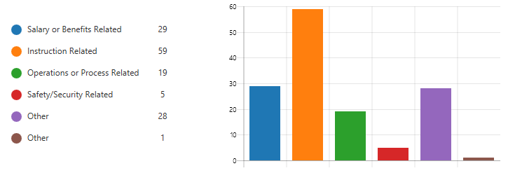
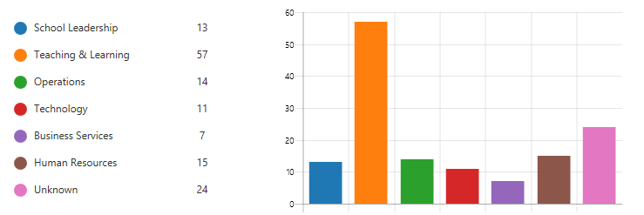
Thank You For Budget Ideas and Feedback Visit our Website (Budget Feedback)

Slide 29
Budget Policy and Structure
Engage. Inspire. Prepare.

Slide 30
Budget Policy and Structure
Fund Accounting
Fund accounting is a system of accounting used by governments to track specific activities. The focus of fund accounting is on accountability, rather than profitability. Funds are categorized by Fund Type and have separate rules about what money goes in and how it is spent.
“The Board of Education (Board) will adopt the non-appropriated budget at the aggregate level of fund type as its legal level of control (for example, governmental fund types of general fund, special revenue, capital projects, etc.).” “Annual budgets are adopted for all funds except trust and agency funds.” BOE Policy DB
3 | Budget Policy & Structure

Slide 31
Budget Structure: Fund Types
The District reports the following appropriated major governmental funds:
The General Fund is the District's primary operating fund. It accounts for and reports all financial resources not accounted for and reported in another fund. All Departments operate within the General Fund.
Special Revenue Funds account for resources that are legally restricted for specific purposes. Although reported within the General Fund for audited financial reporting, Special Revenue Funds are presented separately for budget appropriation and internal reporting purposes.
Capital Projects Funds account for and reports financial resources including education Special Purpose Local Option Sales Tax (E-SPLOST), bond proceeds and grants from the Georgia State Financing and Investment Commission that are restricted, committed or assigned for capital outlay expenditures, including the acquisition or construction of capital facilities and other capital assets.
Debt Service Funds account for and reports financial resources that are restricted, committed or assigned including taxes (property and sales) legally restricted for the payment of general long-term principal and interest and paying agent’s fees.
3 | Budget Policy & Structure

Slide 32
Budget Policy and Structure
Fiduciary Funds: The District is the trustee, or fiduciary, for assets that belong to others, such as school clubs and organizations within the school activity accounts. Fiduciary Funds are not appropriated in the budget.
“The Board must approve the annual budget as required by Georgia law and the Georgia Department of Education. The Superintendent, as Treasurer of the Board, is authorized and directed to spend funds of the Board in accordance with this policy and other approved policies and procedures.
Fund: General Fund (1)
Function: Instruction (14)
Facility: Burnt Hickory (44)
Program: Kindergarten (62)
Object: Salaries (150)
3 | Budget Policy & Structure

Slide 33
Budget Policy and Structure
The Superintendent is authorized by the Board to approve cumulative adjustments of less than ten (10) percent of the amount originally appropriated for expenditures in any fund type. The Superintendent will report to the Board, on a quarterly basis, all expenditures with budget adjustments in excess of $100,000. Under no circumstances is the Superintendent or other staff authorized to spend funds that exceed the total budget as approved by the Board of Education.”
Fund: General Fund
Function: Instruction
Object: Teacher
“The Chief Financial Officer will prepare and present the annual budget by, fund, function and object for management control; however, the Board's legal level of control will be set at the aggregate level of fund type.”
Board Policy DB
3 | Budget Policy & Structure

Slide 34
Fund Balance
Fund balance is a measurement of available financial resources and is the difference between total assets and total liabilities in each fund.
Fund balance for governmental funds is reported in classifications that comprise a hierarchy based primarily on the extent to which the government is bound to honor constraints on the specific purposes for which amounts in those funds can be spent.
The School District's fund balances are classified as follows:
Nonspendable
Restricted
Committed
Assigned
Unassigned
The Board authorizes the Chief Financial Officer to assign Fund Balance.
A minimum Fund Balance of 1.5 months of budgeted expenditures should be maintained in the General Fund (unassigned).
Board Policy DCL: Fund Balance
3 | Budget Policy & Structure

Slide 35
Budget Process
Engage. Inspire. Prepare.

Slide 36
District Budget Process: Development Stages
Process Review July - September | Framework October - December | Development I January - March | Development II April - June
Budget feedback is solicited from various stakeholder groups Develop timeline for the next fiscal year budget Key stakeholders review the previous year’s budget processes Enhancements to the budget development process and reports are identified and work begins to make these adjustments Review begins on the Strategic Plan, including Performance Objectives, Initiatives and Measures | Budget feedback is solicited from various stakeholder groups Feedback begins on Budget Priorities Feedback begins on Budget Strategies Initial Major Budget Influencers are identified An early outlook on the next budget is developed Initial enrollment and allotment assumptions are developed | Budget feedback is solicited from various stakeholder groups Budget Priorities and Strategies are finalized Enrollment projections and allotment assumptions are finalized Major Budget Influencers and assumptions are finalized State budget is approved, including QBE and Equalization Grant Initial local digest is received Budget Timeline, Primer and Outlook Presentations | Budget feedback is solicited from various stakeholder groups Pre-Consolidated local digest received Position allotments are finalized Numerous advertisements are notices are published Two public meetings regarding the budget are held Tentative budget approval Original budget approval Revenue & Allotment, Tentative Budget and Original Budget Presentations
Budgeting for Outcomes, Government Finance Officers Association (GFOA), October 2012
4 | Budget Process
Notes:
Not the Budget Development Calendar

Slide 37
District Budget Process: Overview
Budgeting for Outcomes. A performance budgeting process based on the BOE and district leadership identifying priorities (eight to ten high-level priorities) that reflect the desired results of the community. These priorities form the basis for organizing the budgeting process and are validated against Strategic Plan Goal Areas and Performance Objectives to confirm alignment of budget, strategic plan, community and district leadership.
Price of Government and Major Budget Influencers must also be identified by Business Services and considered within the framework, especially changes in funding and new or expanding influences on the budget, which may be positive or negative and short-term or long-term. Price of Government reflects how much funding is available and is often expressed on a per-pupil basis for comparative purposes.
Major Revenue Influencers
Enrollment Growth
State Budget
QBE:
Enrollment (Weighted, Dual, etc.)
Local Fair Share
Teacher Pay Scales
TRS Employer Contribution
Equalization Grant:
Wealth per Weighted FTE Impact
Changes in Local Sources:
Ad Valorem (Millage Rate)
TAVT
Major Expenditure Influencers
Enrollment Growth
ESEP Growth
Allotment Assumptions
State Teacher Scales (Local Impact)
Step Increases
TRS Employer Contribution
Budgeting for Outcomes, Government Finance Officers Association (GFOA), October 2012
4 | Budget Process

Slide 38
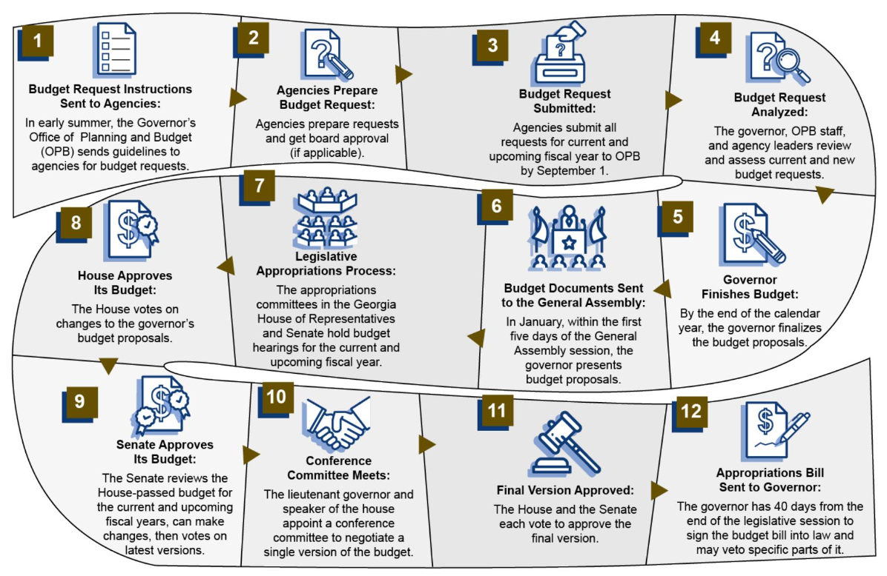
State Budget Process: Overview
The governor proposes the state budget in January. State lawmakers then modify the budget before the governor signs it into law in May. Lawmakers will amendment the current budget during the following legislative session.
2020 Georgia Budget Primer, Georgia Budget & Policy Institute (GBPI), July 2019
4 | Budget Process

Slide 39
Thank You For Budget Ideas and Feedback Visit our Website (Budget Feedback)
Engage. Inspire. Prepare.

Slide 40
Appendix
Engage. Inspire. Prepare.

Slide 41
Land Use
Source: Georgia Department of Revenue, Consolidated Tax Digest Summaries
Appendix

Slide 42
FY2018 Financial Efficiency Star Rating
What is the Financial Efficiency Rating?
O.C.G.A. § 20-14-33 requires that the Governor’s Office of Student Achievement, in coordination with the Georgia Department of Education, create a financial efficiency rating. The Financial Efficiency Star Rating measures an individual school district’s per-pupil spending in relation to the academic achievements of its students.
How is the rating calculated?
The Financial Efficiency Star Rating utilizes a three-year average of per-pupil expenditures and College and Career Ready Performance Index (CCRPI) scores to determine a district’s rating.
Appendix

Slide 43
Children per Household: Comparisons
Source: http://www.census.gov/quickfacts on 1.13.20
Appendix

Slide 44
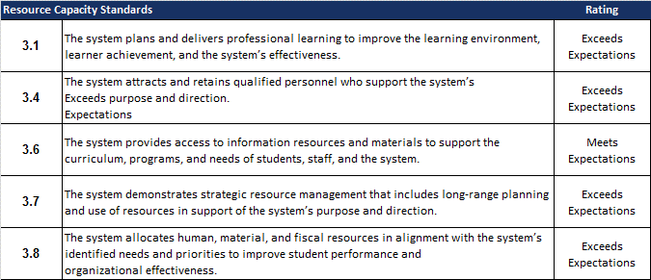
AdvancED
AdvancED Engagement Review Report
Resource Capacity Domain
The use and distribution of resources support the stated mission of the institution. Institutions ensure that resources are distributed and utilized equitably so the needs of all learners are adequately and effectively addressed. The utilization of resources includes support for professional learning for all staff. The institution examines the allocation and use of resources to ensure appropriate levels of funding, sustainability, organizational effectiveness, and increased student learning.
Appendix

Slide 45
Climate Survey
Hanover Research
Climate Survey, Fall 2018
Prioritizing local, state, and federal funds in a way that is equitable, promotes student achievement and is fiscally responsible.
Appendix

